Slide 1


Spinal cord reflexes
Dr. Massara Ghassan Abdulkareem
Physiology Department
College of Medicine\ University of Basrah

Slide 2
Objectives
1. Reflex Arc.
2. Types of Reflex arch
3. Stretch reflex components, and physiology.
University of Basrah-College of Medicine-Physiology Department
1

Slide 3
Bell-Magendie law
in the spinal cord:
the dorsal roots are sensory
the ventral roots are motor
University of Basrah-College of Medicine-Physiology Department
2

Slide 4
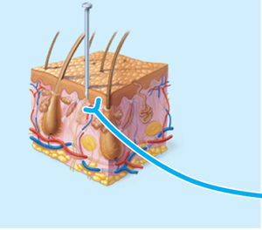
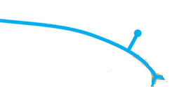
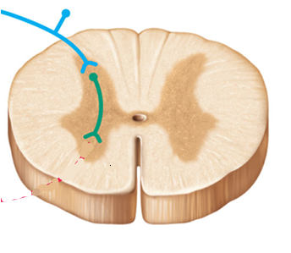
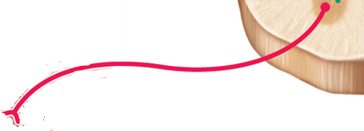
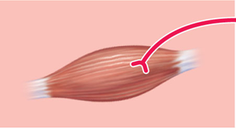
Reflex arc
Stimulus
Skin
Interneuron
1
Receptor
2
Afferent nerve
3
Integration center
4
Efferent nerve
5
Effector
Spinal cord
University of Basrah-College of Medicine-Physiology Department
3

Slide 5
Reflex arc
Monosynaptic
Polysynaptic
University of Basrah-College of Medicine-Physiology Department
4

Slide 6


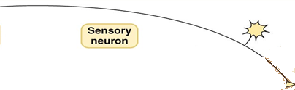
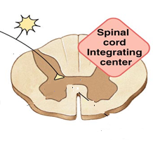




Monosynaptic
One synapse
University of Basrah-College of Medicine-Physiology Department
5

Slide 7

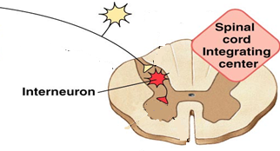


Polysynaptic
Synapse 1
Synapse 2
University of Basrah-College of Medicine-Physiology Department
6

Slide 8
Monosynaptic
Stretch reflex
University of Basrah-College of Medicine-Physiology Department
7

Slide 9
Stretch reflex
reflex contraction of the stretched muscle
sudden stretch of a muscle
University of Basrah-College of Medicine-Physiology Department
8

Slide 10
Components of Stretch reflex
muscle spindle (intrafusal fibers)
receptor
Annulospiral (Ia fibres) +
flower spray endings (II fibres)
afferent
Integrating center
Spinal cord
efferent
motor nerve (alpha fibers)
Muscle (extrafusal fibers)
effector
University of Basrah-College of Medicine-Physiology Department
9

Slide 11
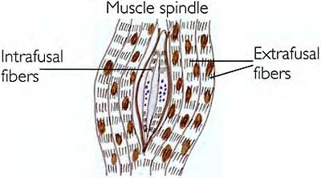
University of Basrah-College of Medicine-Physiology Department
10

Slide 12
Stretch reflex receptor ( Muscle Spindle)
Muscle spindle consists of 3-12 small muscle fibres (intrafusal fibres)within connective tissue capsule.
parallel to extrafusal fibres & attached to it or to tendons.
University of Basrah-College of Medicine-Physiology Department
11

Slide 13
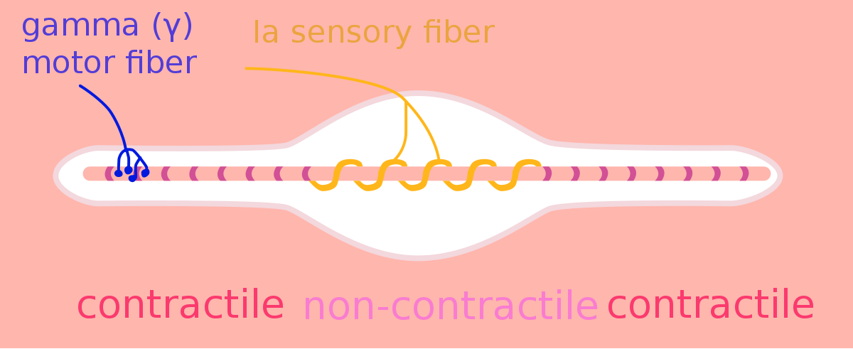
University of Basrah-College of Medicine-Physiology Department
12

Slide 14
Each intrafusal fiber has:
-Central part
non-contractile area (receptor)
  Peripheral contractile part
  on sides of central zone has actin& myosin.
University of Basrah-College of Medicine-Physiology Department
13

Slide 15

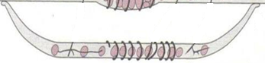
Two types of intrafusal fibres:
  1-Nuclear bag fibres :
  central area is dilated with group of nuclei
  2-Nuclear chain fibres:
  Thinner& shorter -
  -one line of nuclei in a chain in the receptor zone
  - bind to nuclear bag on each side
University of Basrah-College of Medicine-Physiology Department
14

Slide 16
two subtypes of nuclear bag fibers
dynamic
static
  Nuclear chain fibers:
static
University of Basrah-College of Medicine-Physiology Department
15

Slide 17
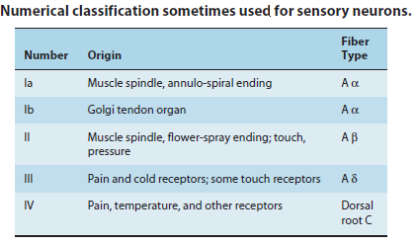
University of Basrah-College of Medicine-Physiology Department
16

Slide 18
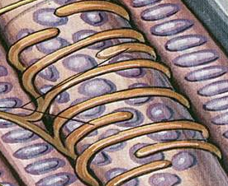
Innervation of the muscle spindle
It has afferent & efferent nerve fibers
1-Sensory Afferent fibres:
-Central receptor area of the intrafusal muscle fibres is supplied by TWO types of afferent fibres:
A-Primary (annulospiral) endings (Ia fibres):
fast, encircle receptor areas of both nuclear
bag and nuclear chain fibres
University of Basrah-College of Medicine-Physiology Department
17

Slide 19
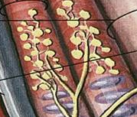
B-Secondary (flower-spray) (Group II) sensory endings:
supplying receptor area of
the nuclear chain fibres ONLY
University of Basrah-College of Medicine-Physiology Department
18

Slide 20
Both the primary and the secondary endings respond to the static response
(Discharge throughout the period of sustained stretch)
The Primary endings (but not the secondary
ending) respond to the dynamic response.
  (Discharge most rapidly if the muscle is suddenly stretched as in tendon jerks)
University of Basrah-College of Medicine-Physiology Department
19

Slide 21
Efferent fibres to spindle (Anterior Motor Neurons)
-gamma motor neurons >>>>gamma efferent 30% >>>>> to the peripheral contractile parts of the intrafusal muscle fibers
70% >>> Alpha efferent to extrafusal muscle fibers
Effect of gamma efferent discharge:-
- gamma efferent increase sensitivity of muscle spindle to stretch
20

Slide 22
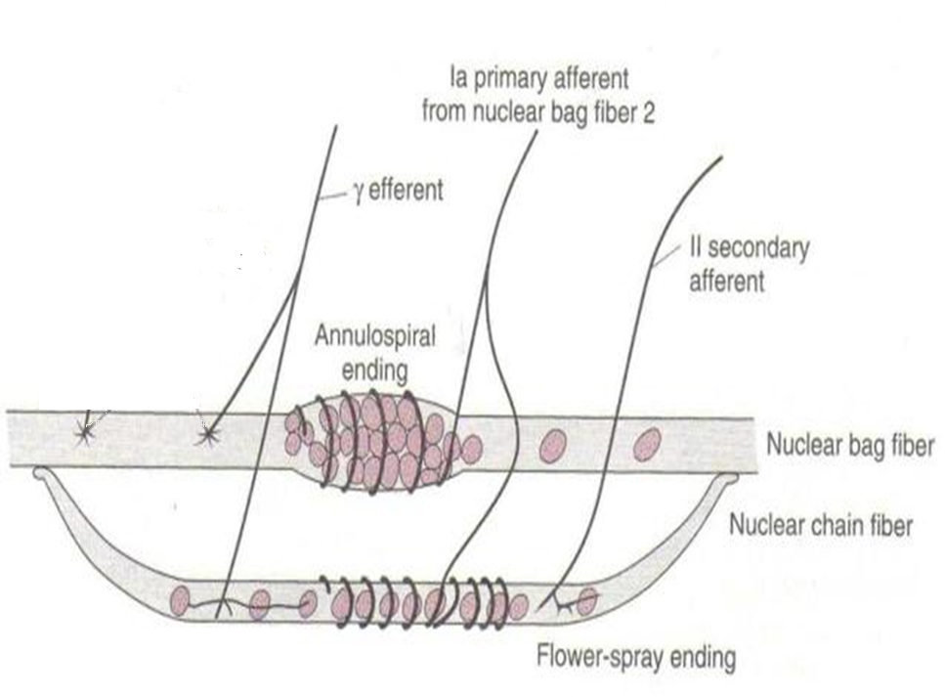
21

Slide 23
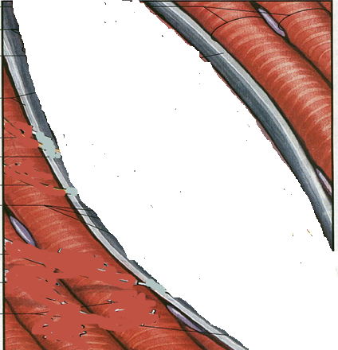
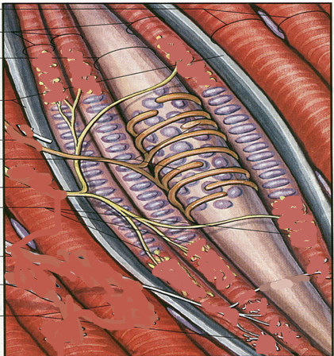
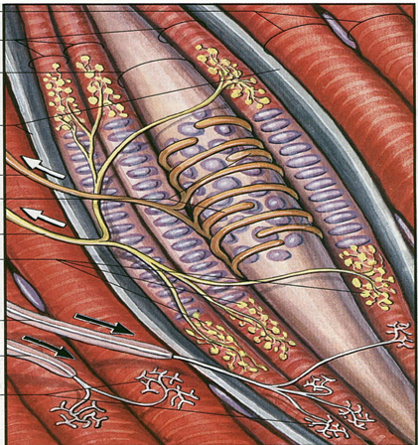
intrafusal fibers
Nuclear chain with
flower spray endings
Nuclear bag with annulospiral endings
Extrafusal fibers
Gamma fiber
alpha fiber
University of Basrah-College of Medicine-Physiology Department
22

Slide 24
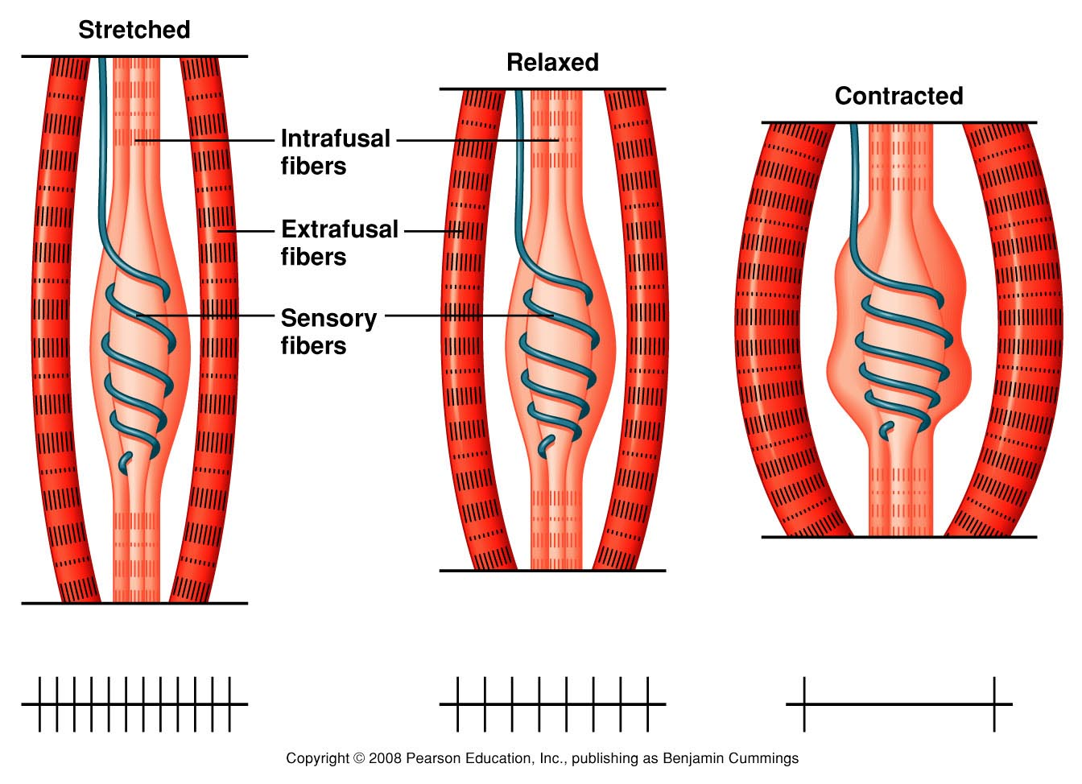
23

Slide 25
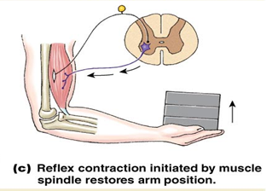
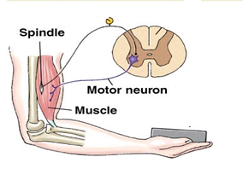
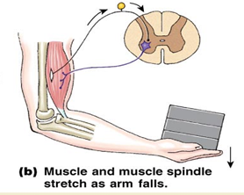
+
+
+
+
University of Basrah-College of Medicine-Physiology Department
25

Slide 26
Types of responses
Component of stretch reflex
1-Dynamic stretch reflex (dynamic response)
Sudden rapid stretch of a muscle >>>>>
(jerk movement)
University of Basrah-College of Medicine-Physiology Department
26

Slide 27
This is the basis of tendon jerk
( contraction followed by relaxation)
Why relaxation follow the contraction?
When muscle contract, it shortens, muscle spindle relax>>> no discharge of nerve endings, and muscle relax
University of Basrah-College of Medicine-Physiology Department
27

Slide 28
2- Static stretch reflex( static response)
mild sustained contraction of muscle extrafusal fibers as long as it is stretched
  Basis of muscle tone
University of Basrah-College of Medicine-Physiology Department
28

Slide 29
knee jerk
Clinical example of stretch reflex
University of Basrah-College of Medicine-Physiology Department
29

Slide 30

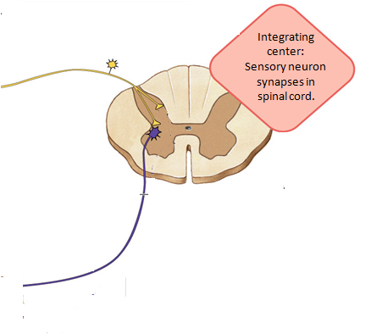

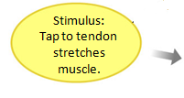

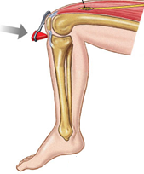
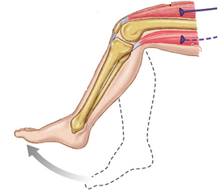



University of Basrah-College of Medicine-Physiology Department
30

Slide 31
Functions of muscle spindle:-
1- keep CNS informed about muscle length & rate or velocity of change in muscle length
2-muscle spindle act to maintain muscle length against rupture
Muscle spindles monitor muscle length and prevent overstretching of the muscle.
3- Damping function ( smoothing muscle contraction)
University of Basrah-College of Medicine-Physiology Department
31

Slide 32
In a muscle spindle receptor, which type of muscle fiber is responsible for the dynamic response?
A) Extrafusal muscle fiber
B) Smooth muscle fiber
C) Nuclear chain fiber
D) nuclear bag fiber
University of Basrah-College of Medicine-Physiology Department
32

Slide 33
Reciprocal inhibition with stretch reflex
-Reflex contraction of an agonistic muscle is accompanied by inhibition of the antagonistic muscle ex:
( contraction of biceps + inhibition of the triceps).
University of Basrah-College of Medicine-Physiology Department
33

Slide 34
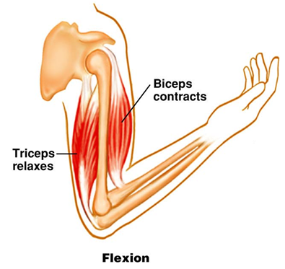
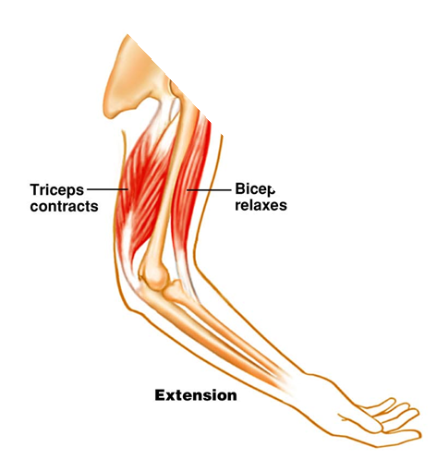
Antagonistic Muscles
University of Basrah-College of Medicine-Physiology Department
34

Slide 35
  -impulses from stretched muscle>>>> spinal cord to cause:-
  1-stimulate the motor neurons of
  the stimulated muscle
  2- send collaterals >>>> inhibitory interneurons synapse on the AHCs of the antagonistic muscle & inhibit them
University of Basrah-College of Medicine-Physiology Department
35

Slide 36
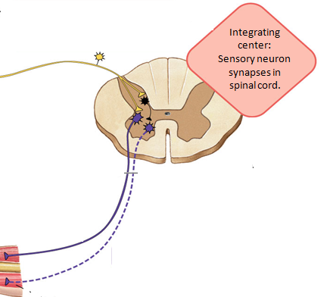



University of Basrah-College of Medicine-Physiology Department
36

Slide 37
Stretch of an innervated muscle evokes :
a- contraction of its spindles
b- contraction of its extrafusal fibers
c- contraction of antagonistic muscles
d- relaxation of synergistic muscles
University of Basrah-College of Medicine-Physiology Department
37

Slide 38
Recap
1. Reflex arch started by receptors (muscle spindles and end by muscle.
2. muscle spindles (sense receptors of the muscle.(Nuclear bag, Nuclear chain)
3. afferent nerve endings (primary, secondary)
4. anterior motor neurns(alpha, gama motor neurons)
University of Basrah-College of Medicine-Physiology Department
38

Slide 39
Thank You

